Slide 1
Sustainability Business Model for SME’s
Formal jobs with MSMEs also create 7 out of 10 jobs (World Bank, 2019)
Sustainability can unlock global business potential USD 12 trillion by 2030.
Yet, OIC countries still lag in the SDG index (survival entrepreneurship)
MSMEs contribute up to 40% of national GDP in emerging markets
600 million jobs needed by the year 2030 to adhere to global workforce growth (World Bank, 2019).

Slide 2
SDG index
Under the pandemic conditions in 2020, the economies of OIC countries, on average, contracted moderately by the rate of 1.6%, and they are expected to recover with a growth rate of 4.3% in 2021 and 4.5% in 2022 –around the past ten-year average.
Merchandise exports of OIC countries fell even sharper, by 17% to US$ 1.49 trillion, While their exports to non-OIC countries shrank 18.5%
In OIC countries, the number of unemployed increased by over 4 million to reach 49.3 million in 2020. remained higher than in the rest of the world.

Slide 3
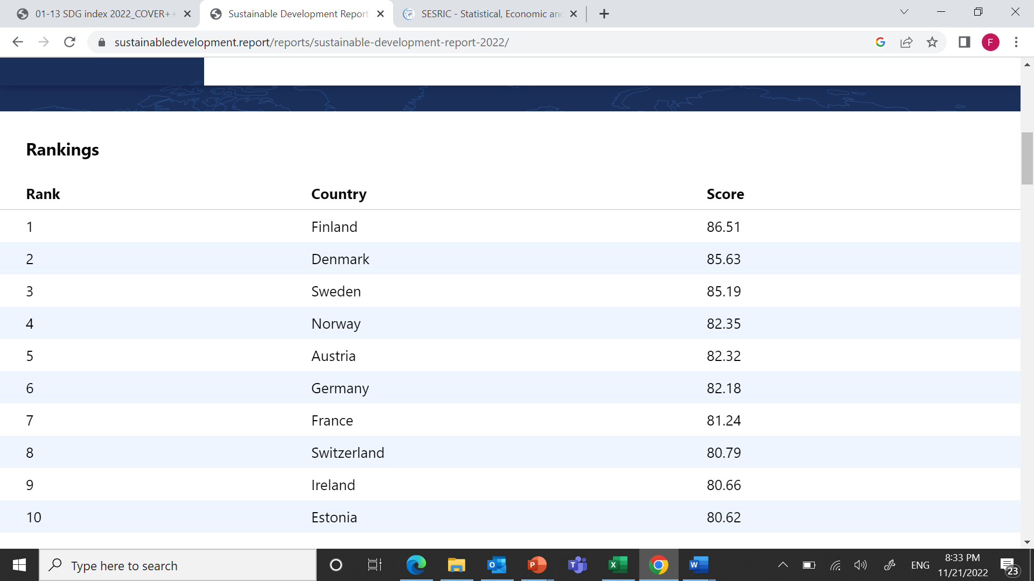
Top 10 countries in SDG index

Slide 4
SDG index for Arab Countries

Slide 5
Smaller are leaner
economic crises have a significant impact on businesses, but the impact is uneven among them (Narjoko & Hill, 2007).
Soininen, Puumalainen, Sjögrén, and Syrjä (2012) found that innovative and proactive firms have more tolerance towards extremely harsh market conditions.
Smaller enterprises may be more flexible than larger ones in adjusting to an economic downturn because they are less resistant to inertia, rigidity, sunk costs (Bourletidis & Triantafyllopoulos, 2014; Tan & See, 2004) and able to find opportunities in market niches (Narjoko & Hill, 2007).
Small
Digital
Adaptive
Flexible
Dynamic

Slide 6
Sustainability Framework

Slide 7
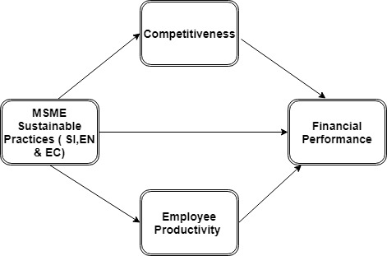
Sustainability Business Model for SME’s

Slide 8
From Halal to Tayyeb
ESG compliance with Sharia compliance as sustainability does not contravene the Sharia and it can induce the industry to go beyond halal products/services but transforming to the Al Tayyib (sourced from goodness).

Slide 9
Thank You

